Slide 1

Sampling of bandpass signal
Starting from a continuous time and real-valued signal x(t) whose spectrum is bandpass [f₁, f₂], we already know that the modulus of its Fourier transform has a symmetrical representation
$$\left|X(f)\right|$$
B = f₂ – f₁
And f_{c} = (f₁ + f₂ ) /2
max
f
- f₂
- f₁
f₁
f_{c}
f₂
B = f₂ – f₁

Slide 2

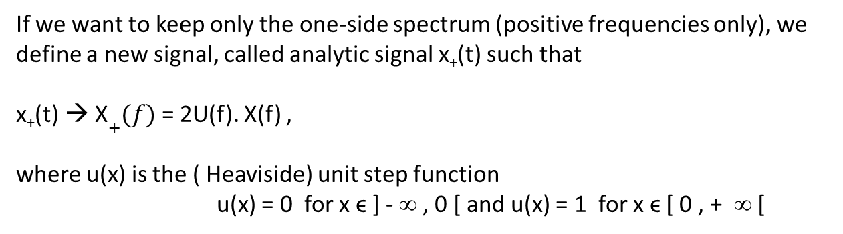
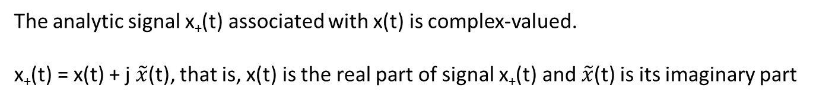
If we want to keep only the one-side spectrum (positive frequencies only), we define a new signal, called analytic signal x₊(t) such that
x₊(t) → X$+(f)$= 2U(f). X(f) ,
where u(x) is the ( Heaviside) unit step function
u(x) = 0 for x ϵ ] - ∞ , 0 [ and u(x) = 1 for x ϵ [ 0 , + ∞ [
$$\left|\text{X}+(f)\right|$$
2 max
f
f₁
f_{c}
f₂
The analytic signal x₊(t) associated with x(t) is complex-valued.
x₊(t) = x(t) + j $\tilde{x}$(t), that is, x(t) is the real part of signal x₊(t) and $\tilde{x}$(t) is its imaginary part

Slide 3
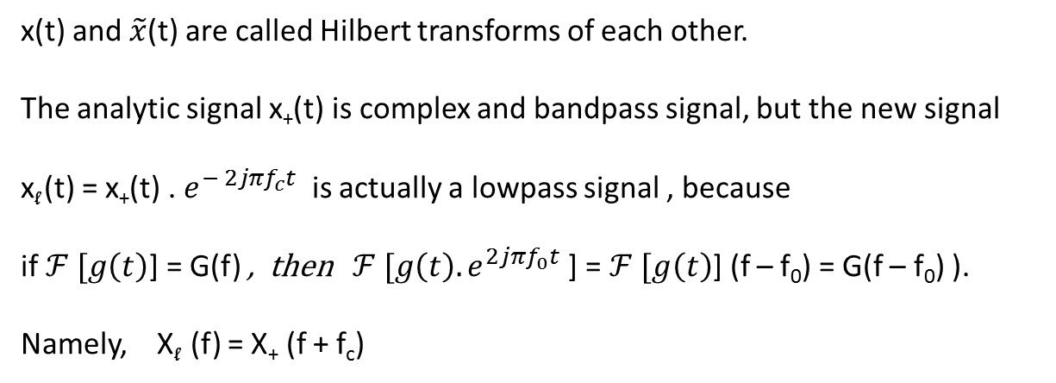

In fact, $\tilde{x}$(t) = $\frac{1}{πt} ∗x\left(t\right)= \int_{−∞}^{∞}{\begin{aligned} \frac{x(t^{′})}{π(t−t^{′})} .dt′ \\ \end{aligned}}$
x(t) and $\tilde{x}$(t) are called Hilbert transforms of each other.
The analytic signal x₊(t) is complex and bandpass signal, but the new signal
x_{l} (t) = x₊(t) . $e^{− 2jπf_{c}t}$ is actually a lowpass signal , because
if $ℱ [g\left(t\right)$] = G(f) , then $ℱ [g\left(t\right). e^{2jπf_{0}t}$] = $ℱ [g\left(t\right)$] (f – f₀) = G(f – f₀) ).
Namely, X_{l} (f) = X₊ (f + f_{c})
$$\left|\text{X}\text{l} (f)\right|$$
2 max
In addition, x_{l} (t) is complex valued signal…
x_{l} (t) = u_{c}(t) + j u_{s}(t)
_{- B/2}
₀
_{B/2}
f
_{B}

Slide 4
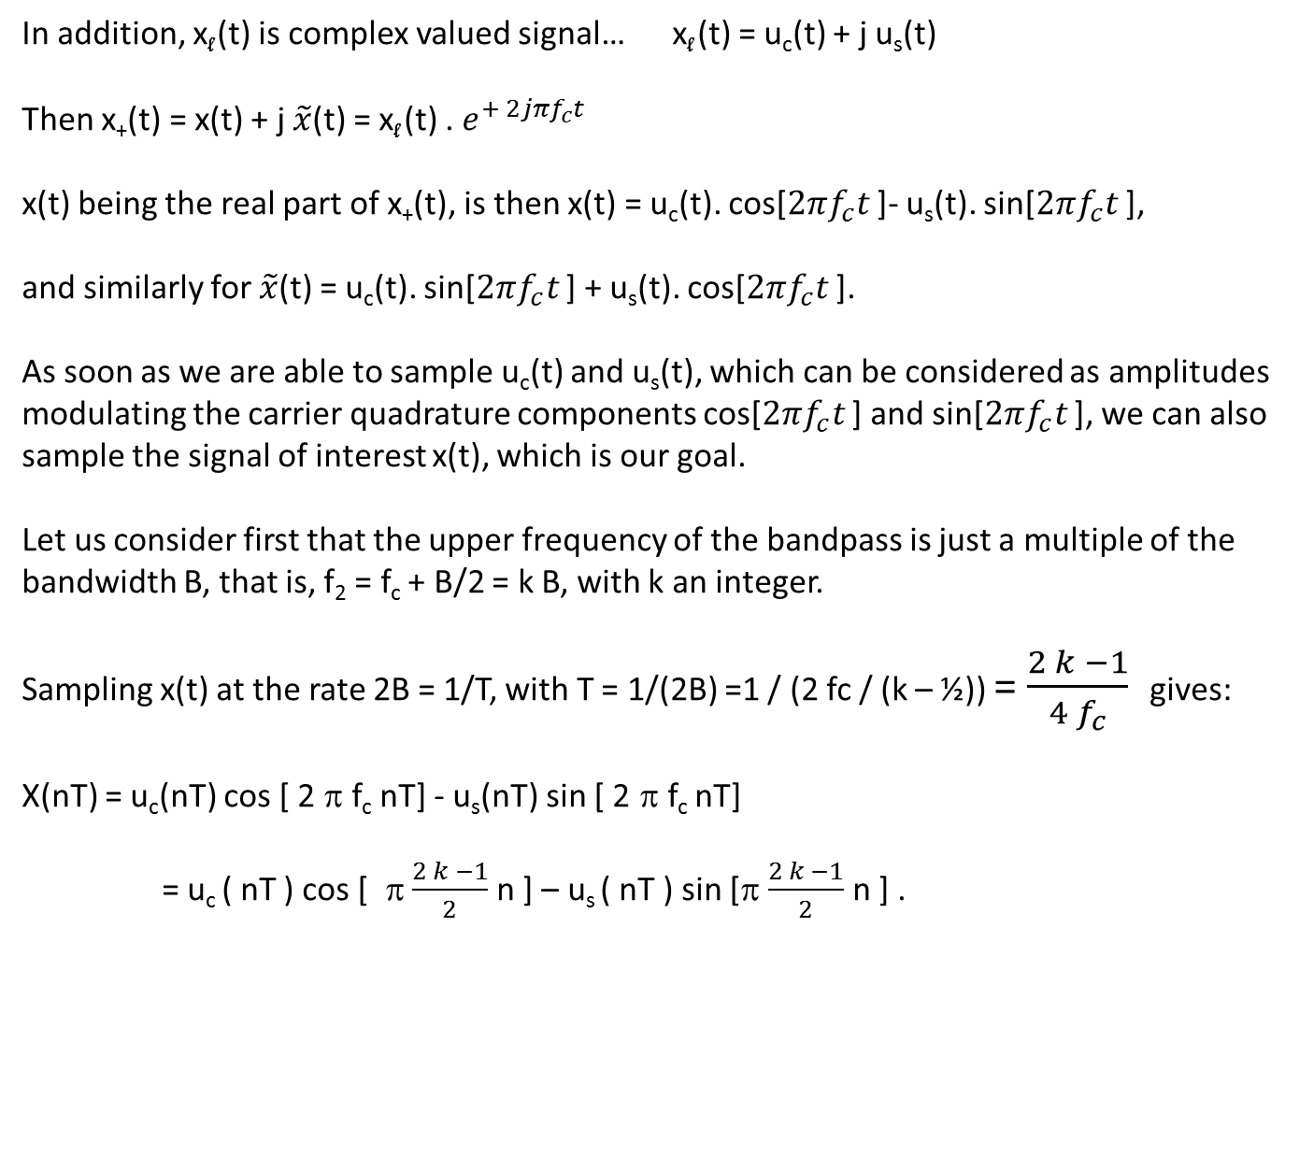
In addition, x_{l} (t) is complex valued signal… x_{l} (t) = u_{c}(t) + j u_{s}(t)
Then x₊(t) = x(t) + j $\tilde{x}$(t) = x_{l} (t) . $e^{+ 2jπf_{c}t}$
x(t) being the real part of x₊(t), is then x(t) = u_{c}(t). cos[$2πf_{c}t$ ]- u_{s}(t). sin[$2πf_{c}t$ ],
and similarly for $\tilde{x}$(t) = u_{c}(t). sin[$2πf_{c}t$ ] + u_{s}(t). cos[$2πf_{c}t$ ].
As soon as we are able to sample u_{c}(t) and u_{s}(t), which can be considered as amplitudes modulating the carrier quadrature components cos[$2πf_{c}t$ ] and sin[$2πf_{c}t$ ], we can also sample the signal of interest x(t), which is our goal.
Let us consider first that the upper frequency of the bandpass is just a multiple of the bandwidth B, that is, f₂ = f_{c} + B/2 = k B, with k an integer.
Sampling x(t) at the rate 2B = 1/T, with T = 1/(2B) =1 / (2 fc / (k – ½)) = $\frac{2 k −1}{{4 f}_{c}}$ gives:
X(nT) = u_{c}(nT) cos [ 2 π f_{c} nT] - u_{s}(nT) sin [ 2 π f_{c} nT]
= u_{c} ( nT ) cos [ π $\frac{2 k −1}{2}$ n ] – u_{s} ( nT ) sin [π $\frac{2 k −1}{2}$ n ] .

Slide 5
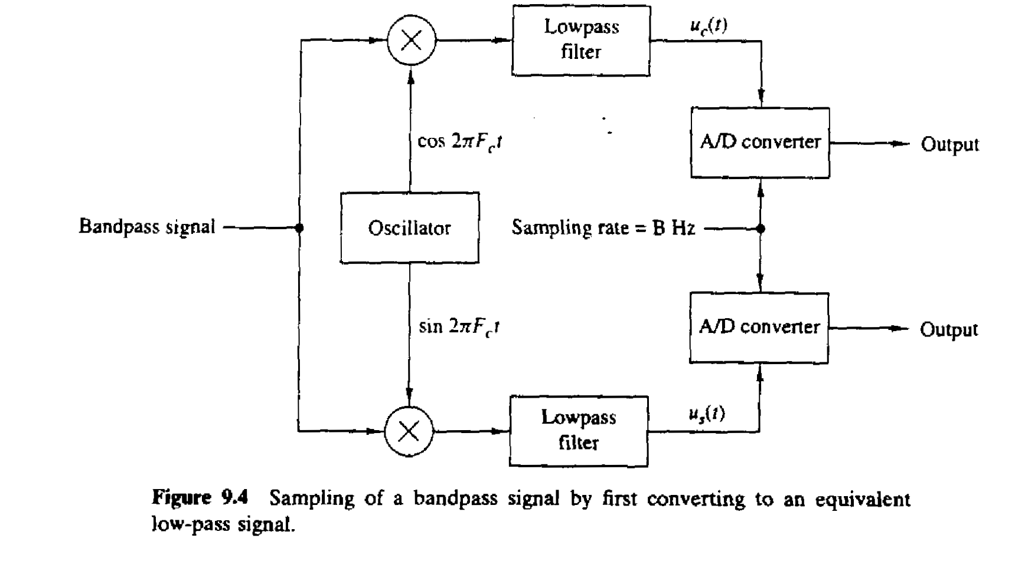
A(t)
U_{c} (n /B)
U_{s} (n /B)
B(t)

Slide 6
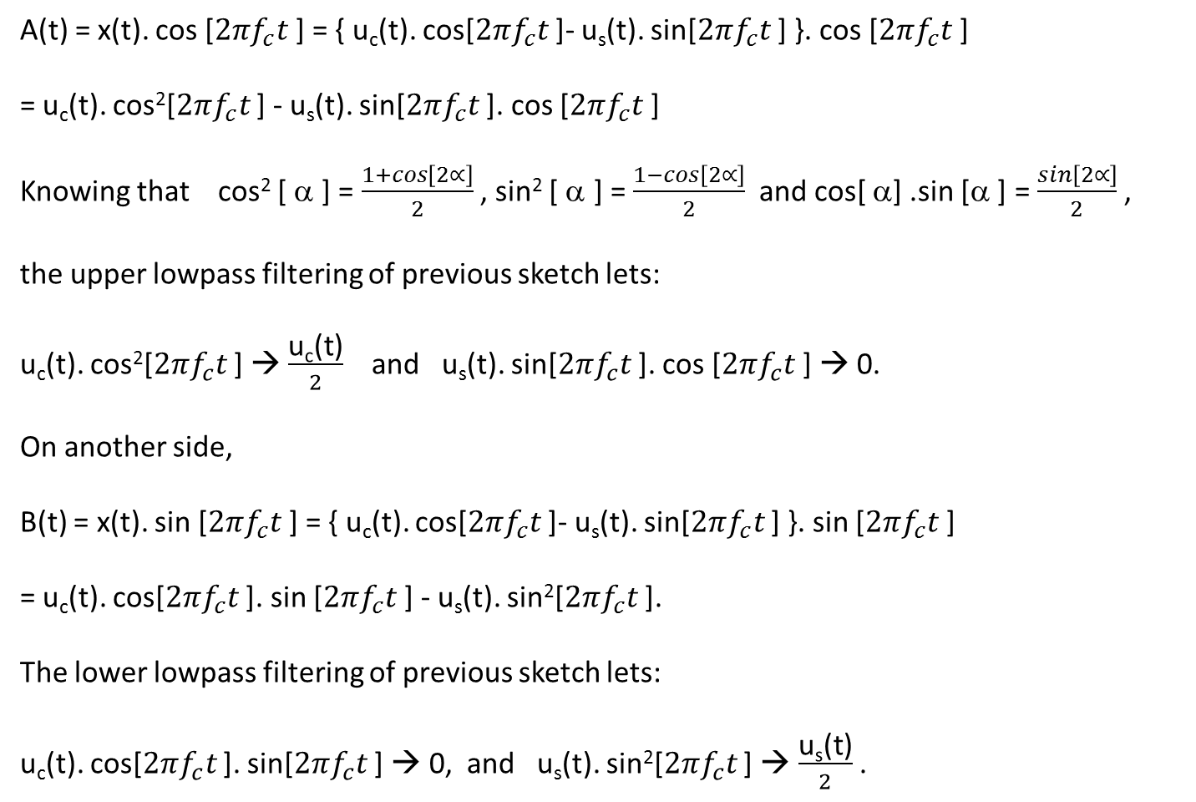
A(t) = x(t). cos [$2πf_{c}t$ ] = { u_{c}(t). cos[$2πf_{c}t$ ]- u_{s}(t). sin[$2πf_{c}t$ ] }. cos [$2πf_{c}t$ ]
= u_{c}(t). cos²[$2πf_{c}t$ ] - u_{s}(t). sin[$2πf_{c}t$ ]. cos [$2πf_{c}t$ ]
Knowing that cos² [ α ] = $\frac{1+cos\left[2∝\right]}{2}$ , sin² [ α ] = $\frac{1−cos\left[2∝\right]}{2}$ and cos[ α] .sin [α ] = $\frac{sin\left[2∝\right]}{2}$ ,
the upper lowpass filtering of previous sketch lets:
u_{c}(t). cos²[$2πf_{c}t$ ] → $\frac{\text{u}\text{c}\text{(}\text{t}\text{)}}{2}$ and u_{s}(t). sin[$2πf_{c}t$ ]. cos [$2πf_{c}t$ ] → 0.
On another side,
B(t) = x(t). sin [$2πf_{c}t$ ] = { u_{c}(t). cos[$2πf_{c}t$ ]- u_{s}(t). sin[$2πf_{c}t$ ] }. sin [$2πf_{c}t$ ]
= u_{c}(t). cos[$2πf_{c}t$ ]. sin [$2πf_{c}t$ ] - u_{s}(t). sin²[$2πf_{c}t$ ].
The lower lowpass filtering of previous sketch lets:
u_{c}(t). cos[$2πf_{c}t$ ]. sin[$2πf_{c}t$ ] → 0, and u_{s}(t). sin²[$2πf_{c}t$ ] → $\frac{\text{u}\text{s}\text{(}\text{t}\text{)}}{2}$ .

Slide 7
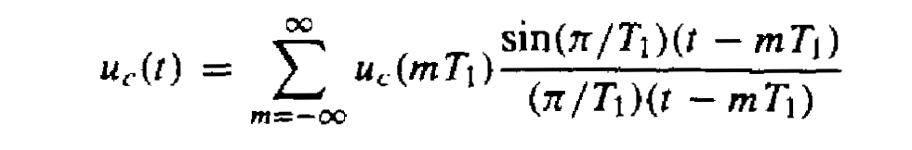
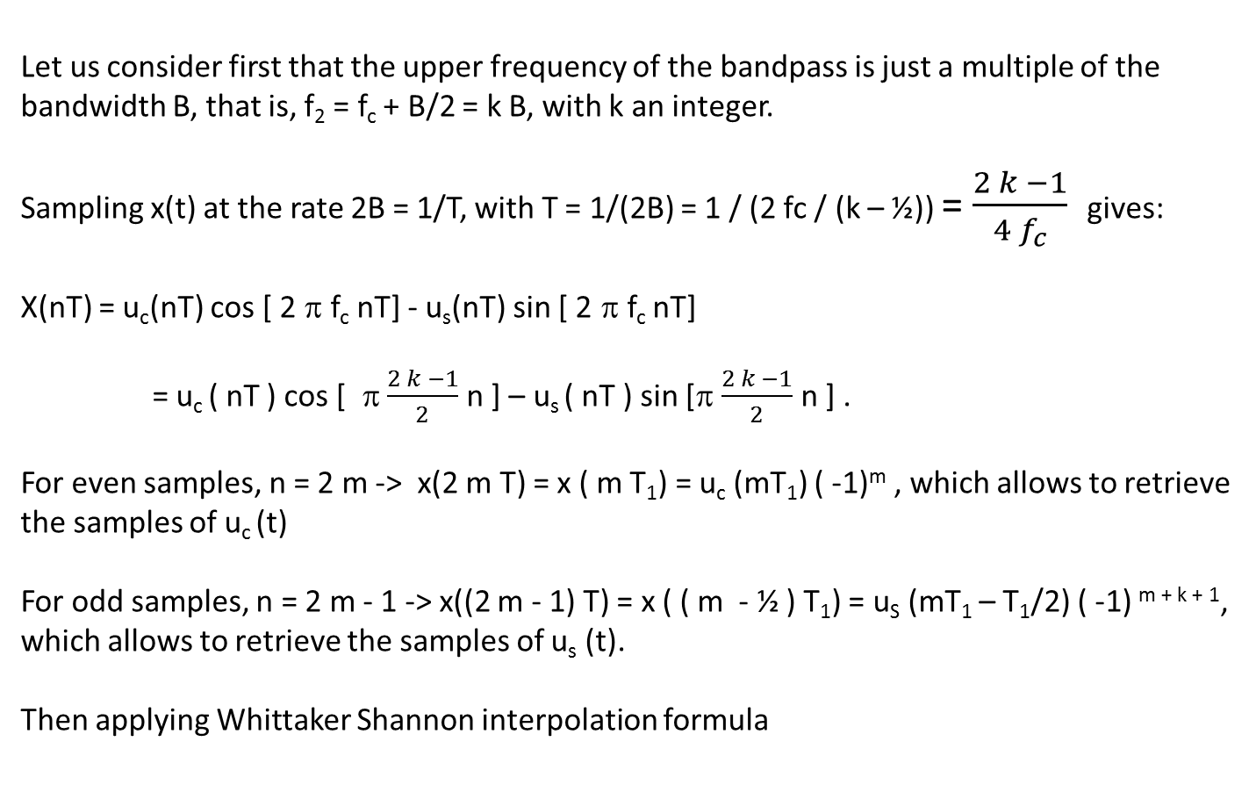
Let us consider first that the upper frequency of the bandpass is just a multiple of the bandwidth B, that is, f₂ = f_{c} + B/2 = k B, with k an integer.
Sampling x(t) at the rate 2B = 1/T, with T = 1/(2B) = 1 / (2 fc / (k – ½)) = $\frac{2 k −1}{{4 f}_{c}}$ gives:
X(nT) = u_{c}(nT) cos [ 2 π f_{c} nT] - u_{s}(nT) sin [ 2 π f_{c} nT]
= u_{c} ( nT ) cos [ π $\frac{2 k −1}{2}$ n ] – u_{s} ( nT ) sin [π $\frac{2 k −1}{2}$ n ] .
For even samples, n = 2 m -> x(2 m T) = x ( m T₁) = u_{c} (mT₁) ( -1)^{m} , which allows to retrieve the samples of u_{c} (t)
For odd samples, n = 2 m - 1 -> x((2 m - 1) T) = x ( ( m - ½ ) T₁) = u_{S} (mT₁ – T₁/2) ( -1) ^{m + k + 1}, which allows to retrieve the samples of u_{s} (t).
Then applying Whittaker Shannon interpolation formula

Slide 8
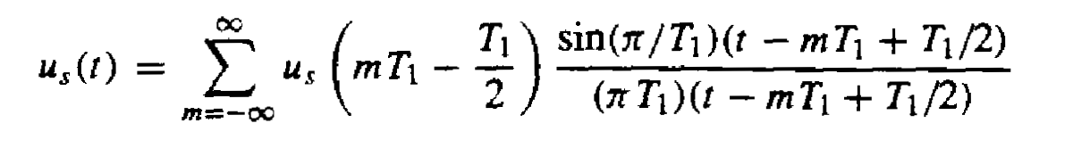
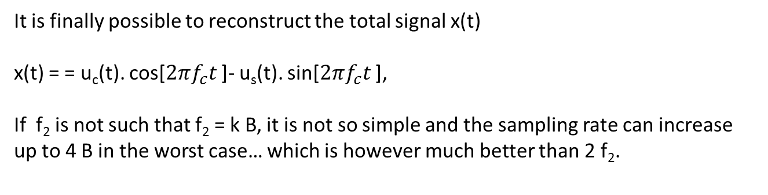
It is finally possible to reconstruct the total signal x(t)
x(t) = = u_{c}(t). cos[$2πf_{c}t$ ]- u_{s}(t). sin[$2πf_{c}t$ ],
If f₂ is not such that f₂ = k B, it is not so simple and the sampling rate can increase up to 4 B in the worst case… which is however much better than 2 f₂.

